Slide 1
Foundations of Business
Intelligence: Databases and
Information Management
Chapter 6
VIDEO CASES
  Case 1a: City of Dubuque Uses Cloud Computing and Sensors to Build a Smarter, Sustainable City
  Case 1b: IBM Smarter City: Portland, Oregon
  Case 2: Data Warehousing at REI: Understanding the Customer
  Case 3: Maruti Suzuki Business Intelligence and Enterprise Databases

Slide 2
Learning Objectives
What are the problems of managing data resources in a traditional file environment?
What are the major capabilities of database management systems (DBMS) and why is a relational DBMS so powerful?
What are the principal tools and technologies for accessing information from databases to improve business performance and decision making?
Why are information policy, data administration, and data quality assurance essential for managing the firm’s data resources?
Notes:
This chapter discusses the role of databases for managing a firm’s data and providing the foundation for business intelligence. Ask students to describe any databases they have encountered or used at work or in their personal use on the Web. For example, Google and Amazon are database driven Web sites, as are travel reservation Web sites, MySpace, Facebook, and, of course, iTunes. Ask students why these sites are driven by databases—what is it about databases that makes the creation and use of these sites more efficient?

Slide 3
Better Data Management Helps Toronto Globe and Mail
Problem:
  Data fragmented in isolated databases and files
  Time-consuming reporting processes
  Outdated data management technology
Solution:
  Replace disparate systems with enterprise system, with centralized mainframe and data management system
Notes:
In an age of nonorganic corporate growth where companies grow by acquiring other companies, business firms quickly become a collection of hundreds of databases, e-mail systems, personnel systems, accounting systems, and manufacturing systems, none of which can communicate with one another. Even if firms grow organically without acquisitions it is common for separate departments and divisions to have their own systems and databases. Firms in this case suffer the same result: the firm becomes a collection of systems that cannot share information. This creates a demand for powerful, enterprise-wide or firm-wide databases that can bring order to the chaos.

Slide 4
Better Data Management Helps Toronto Globe and Mail
SAP enterprise system with SAP NetWeaver BW data warehouse to contain all company’s data; educate users and tools
Demonstrates IT’s role in successful data management
Illustrates digital technology’s ability to lower costs while improving performance
Notes:
In an age of nonorganic corporate growth where companies grow by acquiring other companies, business firms quickly become a collection of hundreds of databases, e-mail systems, personnel systems, accounting systems, and manufacturing systems, none of which can communicate with one another. Even if firms grow organically without acquisitions it is common for separate departments and divisions to have their own systems and databases. Firms in this case suffer the same result: the firm becomes a collection of systems that cannot share information. This creates a demand for powerful, enterprise-wide or firm-wide databases that can bring order to the chaos.

Slide 5
Managing Data in a Traditional File Environment
File organization concepts
  Database: Group of related files
  File: Group of records of same type
  Record: Group of related fields
  Field: Group of characters as word(s) or number
    Describes an entity (person, place, thing on which we store information)
    Attribute: Each characteristic, or quality, describing entity
      Example: Attributes DATE or GRADE belong to entity COURSE
Notes:
This slide describes a hierarchy of data that is used to store information in a database, progressing from the database as the top-level holder of information down through the field, which stores information about an entity’s attribute. This hierarchy is illustrated by the graphic on the next slide. Ask students to come up with some other entities that might be found in a university database (Student, Professor, etc.). What attributes (characteristics) would be important to store in the database?

Slide 6
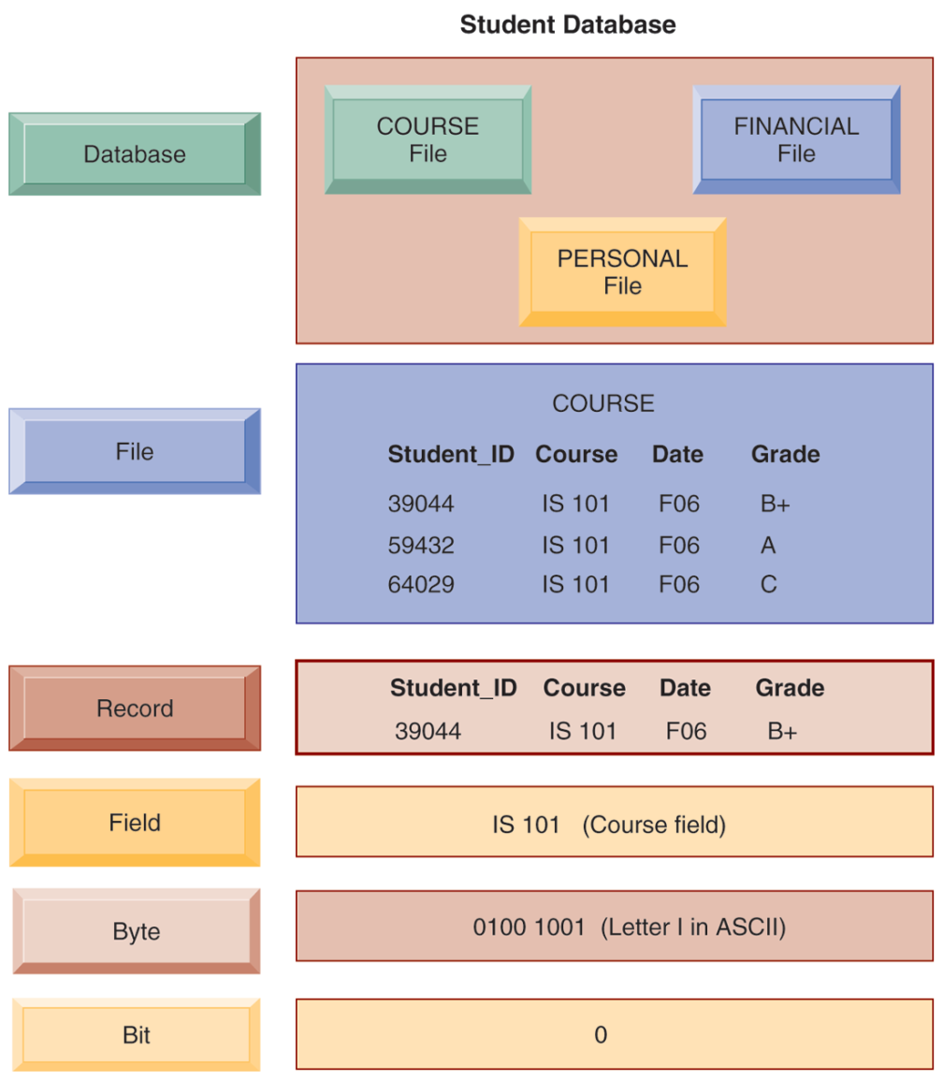
THE DATA HIERARCHY
A computer system organizes data in a hierarchy that starts with the bit, which represents either a 0 or a 1. Bits can be grouped to form a byte to represent one character, number, or symbol. Bytes can be grouped to form a field, and related fields can be grouped to form a record. Related records can be collected to form a file, and related files can be organized into a database.
FIGURE 6-1
Notes:
This graphic illustrates the hierarchy of data found in a database. It shows the student course file grouped with files on students’ personal histories and financial backgrounds that form the student database. It illustrates what data is found at each hierarchical level, from the database level down. Making up the smallest information unit, the field, are smaller units of data, common to all applications: bits and bytes. A bit stores a single binary digit, 0 or 1, and a byte stores a group of digits to represent a single character, number, or other symbol.

Slide 7
Managing Data in a Traditional File Environment
Problems with the traditional file environment (files maintained separately by different departments)
  Data redundancy:
    Presence of duplicate data in multiple files
  Data inconsistency:
    Same attribute has different values
  Program-data dependence:
    When changes in program requires changes to data accessed by program
  Lack of flexibility
  Poor security
  Lack of data sharing and availability
Notes:
This slide discusses the problems in data management that occur in a traditional file environment. In a traditional file environment, different functions in the business (accounting, finance, HR, etc.) maintained their own separate files and databases.
Ask students to describe further why data redundancy and inconsistency pose problems? What kinds of problems happen when data is redundant or inconsistent. Ask students to give an example of program-data dependence. What makes the traditional file environment inflexible?

Slide 8
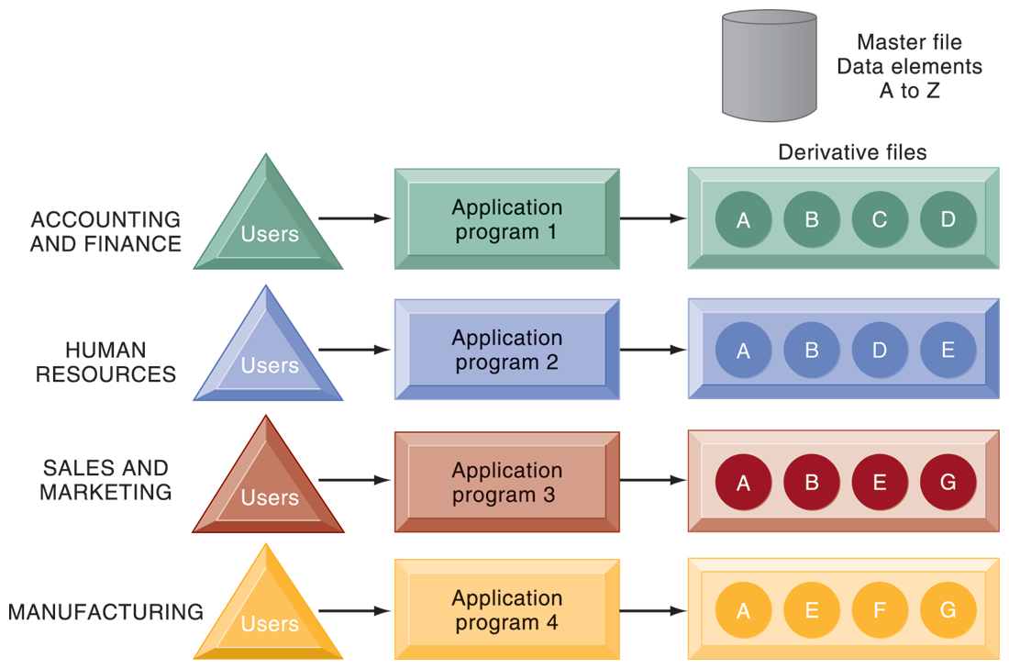
TRADITIONAL FILE PROCESSING
The use of a traditional approach to file processing encourages each functional area in a corporation to develop specialized applications. Each application requires a unique data file that is likely to be a subset of the master file. These subsets of the master file lead to data redundancy and inconsistency, processing inflexibility, and wasted storage resources.
FIGURE 6-2
Notes:
This graphic illustrates a traditional environment, in which different business functions maintain separate data and applications to store and access that data. Ask students what kinds of data might be shared between accounting/finance and HR. What about between sales and marketing and manufacturing?

Slide 9
Capabilities of Database Management Systems (DBMSs)
Database
  Serves many applications by centralizing data and controlling redundant data
Database management system (DBMS)
  Interfaces between applications and physical data files
  Separates logical and physical views of data
  Solves problems of traditional file environment
    Controls redundancy
    Eliminates inconsistency
    Uncouples programs and data
    Enables organization to central manage data and data security
Notes:
This slide defines and describes databases and DBMS. Ask students to explain what the difference is between a database and a DBMS. What is the physical view of data? What is the logical view of data?

Slide 10
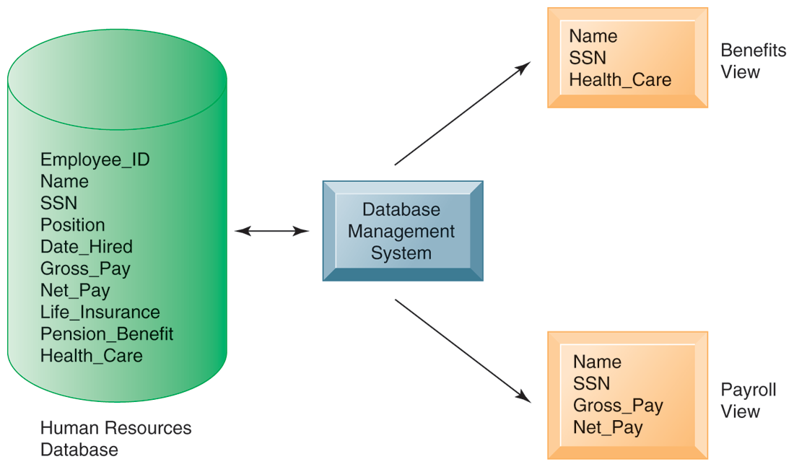
HUMAN RESOURCES DATABASE WITH MULTIPLE VIEWS
FIGURE 6-3
A single human resources database provides many different views of data, depending on the information requirements of the user. Illustrated here are two possible views, one of interest to a benefits specialist and one of interest to a member of the company’s payroll department.
Notes:
This graphic illustrates what is meant by providing different logical views of data. The orange rectangles represent two different views in an HR database, one for reviewing employee benefits, the other for accessing payroll records. The students can think of the green cylinder as the physical view, which shows how the data are actually organized and stored on the physical media. The physical data do not change, but a DBMS can create many different logical views to suit different needs of users.

Slide 11
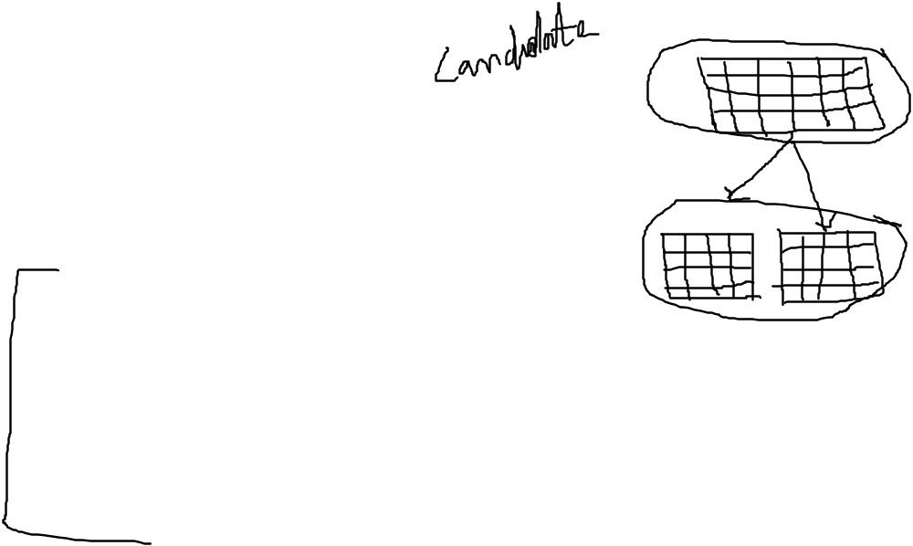
Capabilities of Database Management Systems (DBMSs)
Relational DBMS
  Represent data as two-dimensional tables
  Each table contains data on entity and attributes
Table: grid of columns and rows
  Rows (tuples): Records for different entities
  Fields (columns): Represents attribute for entity
  Key field: Field used to uniquely identify each record
  Primary key: Field in table used for key fields
  Foreign key: Primary key used in second table as look-up field to identify records from original table
Notes:
This slide introduces the most common type of DBMS in use with PCs, servers, and mainframes today, the relational database. Ask students why these DBMS are called relational. Ask students for examples of RDBMS software popular today and if they have every used any of this software. You can walk students through an example database that you have prepared in Access or use one of the exercise data tables found at the end of the chapter. Identify rows, fields, and primary key.

Slide 12
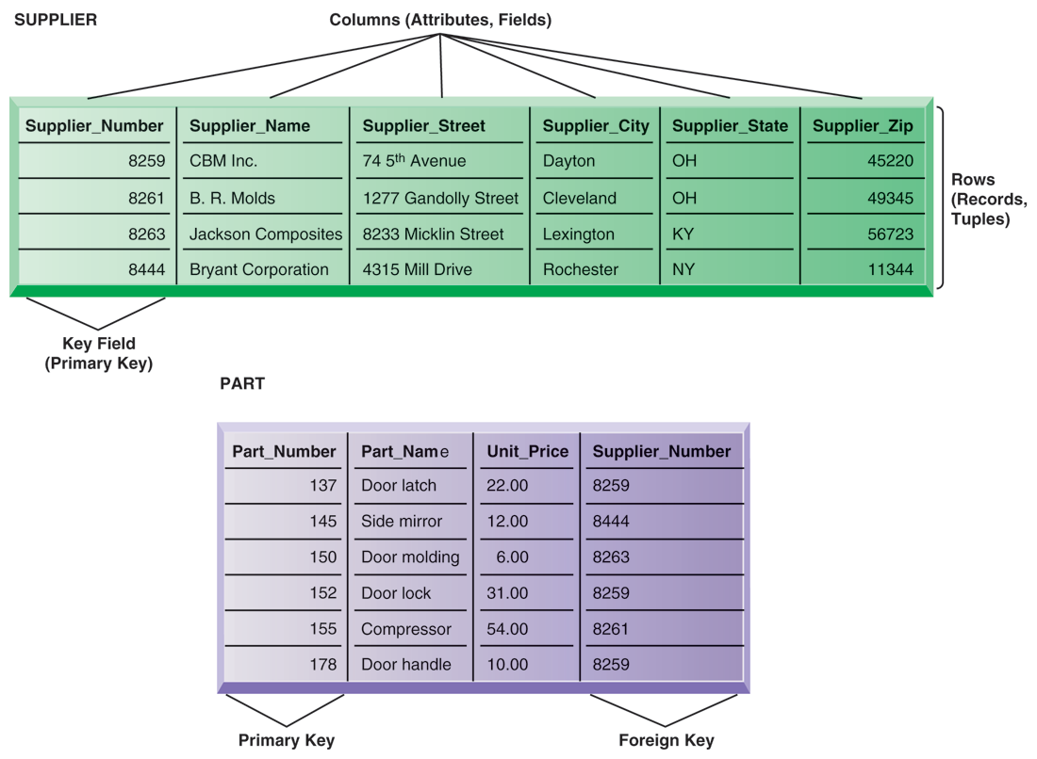
Relational Database Tables
A relational database organizes data in the form of two-dimensional tables. Illustrated here are tables for the entities SUPPLIER and PART showing how they represent each entity and its attributes. Supplier Number is a primary key for the SUPPLIER table and a foreign key for the PART table.
FIGURE 6-4
Notes:
The graphic on this slide illustrates two tables in a relational DBMS. Ask students what the entity on this slide and the next are. The key field in the Supplier table is the Supplier number. What is the purpose of the key field?

Slide 13

Capabilities of Database Management Systems (DBMSs)
Operations of a Relational DBMS
  Three basic operations used to develop useful sets of data
    SELECT: Creates subset of data of all records that meet stated criteria
    JOIN: Combines relational tables to provide user with more information than available in individual tables
    PROJECT: Creates subset of columns in table, creating tables with only the information specified
Notes:
This slide describes how information is retrieved from a relational database. These operations (SELECT, JOIN, PROJECT) are like programming statements and are used by DBMS developers. For example, looking at the last two slides showing the Supplier and Parts table, you would use what kind of an operation to show the Parts records along with the appropriate supplier's name? Access has wizards for these commands.

Slide 14
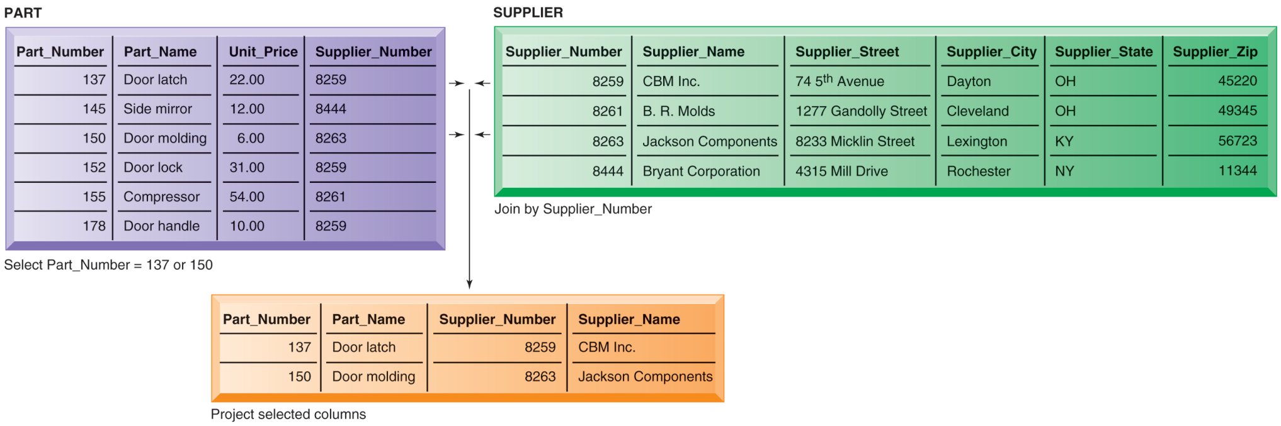

THE THREE BASIC OPERATIONS OF A RELATIONAL DBMS
FIGURE 6-5
The select, join, and project operations enable data from two different tables to be combined and only selected attributes to be displayed.
Notes:
This graphic illustrates the result from combining the SELECT, JOIN, and PROJECT operations to create a subset of data. The SELECT operation retrieves just those parts in the PART table whose part number is 137 or 150. The JOIN operation uses the foreign key of the Supplier Number provided by the PART table to locate supplier data from the Supplier Table for just those records selected in the SELECT operation. Finally, the PROJECT operation limits the columns to be shown to be simply the part number, part name, supplier number, and supplier name (orange rectangle).

Slide 15
Capabilities of Database Management Systems (DBMSs)
Non-relational databases: “NoSQL”
  More flexible data model
  Data sets stored across distributed machines
  Easier to scale
  Handle large volumes of unstructured and structured
  data (Web, social media, graphics)
Databases in the cloud
  Typically, less functionality than on-premises DBs
  Amazon Relational Database Service, Microsoft SQL Azure
  Private clouds
Notes:
This slide discusses other types of DBMS. Ask students why one would want to store social media data in a non-relational database? The answer: social media involves many different file types, and the information is not easily organized into tables of columns and rows. Another option for businesses is to license database software “from the cloud.” What would be an advantage to using a database service? (A primary answer is scalability—you pay only for the exact services you need.)

Slide 16
Capabilities of Database Management Systems (DBMSs)
Capabilities of database management systems
  Data definition capability: Specifies structure of database content, used to create tables and define characteristics of fields
  Data dictionary: Automated or manual file storing definitions of data elements and their characteristics
  Data manipulation language: Used to add, change, delete, retrieve data from database
    Structured Query Language (SQL)
    Microsoft Access user tools for generating SQL
  Many DBMS have report generation capabilities for creating polished reports (Crystal Reports)
Notes:
This slide discusses the three main capabilities of a DBMS: its data definition capability, the data dictionary, and a data manipulation language.
Ask students to describe what characteristics of data would be stored by a data dictionary (name, description, size, type, format, other properties of a field). For a large company, a data dictionary might also store characteristics such as usage, ownership, authorization, security, users.
Note that the data manipulation language is the tool that requests operations such as SELECT and JOIN to be performed on data.

Slide 17
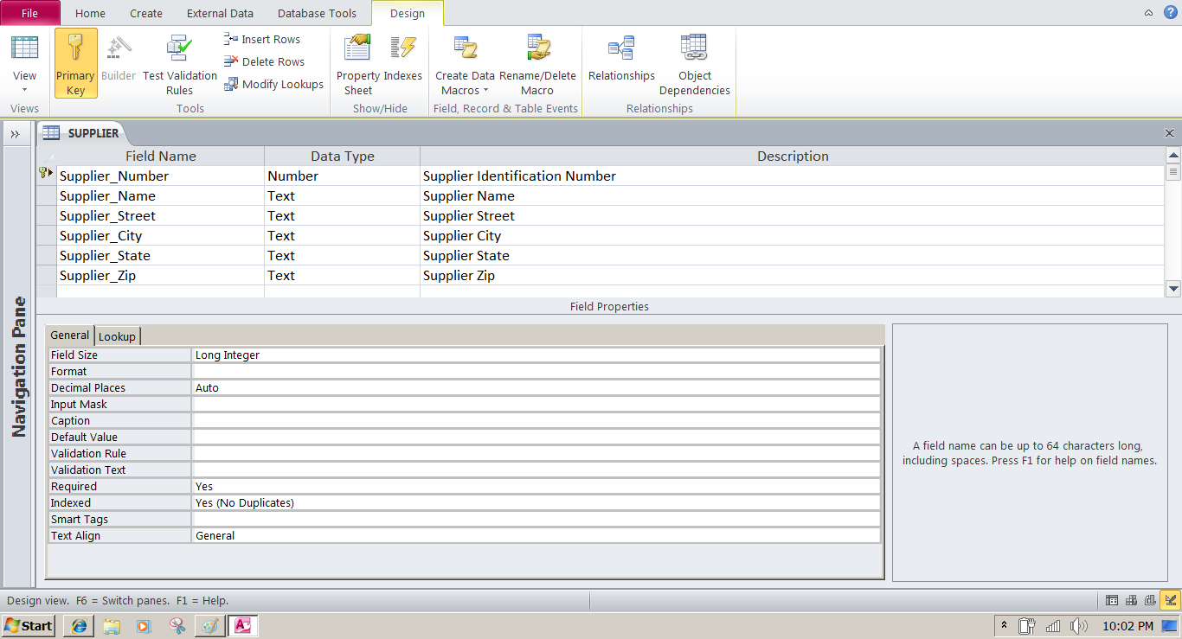
MICROSOFT ACCESS DATA DICTIONARY FEATURES
FIGURE 6-6
Microsoft Access has a rudimentary data dictionary capability that displays information about the size, format, and other characteristics of each field in a database. Displayed here is the information maintained in the SUPPLIER table. The small key icon to the left of Supplier_Number indicates that it is a key field.
Notes:
This graphic shows the data dictionary capability of Microsoft Access. For the field “Supplier Name” selected in the top pane, definitions can be configured in the General tab in the bottom pane. These General characteristics are Fields Size, Format, Input Mask, Caption, Default Value, Validation Rule, Validation Text, Required, Allow Zero Length, Indexed, Unicode Compression, IME mode, IME Sentence Mode, and Smart Tags.

Slide 18
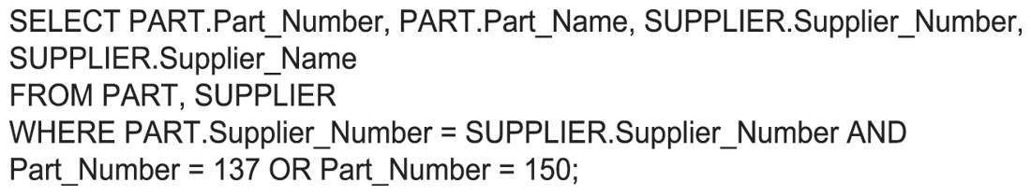
EXAMPLE OF AN SQL QUERY
FIGURE 6-7
Illustrated here are the SQL statements for a query to select suppliers for parts 137 or 150. They produce a list with the same results as Figure 6-5.
Notes:
This graphic shows an example SQL statement that would be used to retrieve data from a database. In this case, the SQL statement is retrieving records from the PART table illustrated on Slide 14 (Figure 6-5) whose Part Number is either 137 or 150.
Ask students to relate what each phrase of this statement is doing. (For example, the statement says to take the following columns: Part_Number, Part_Name, Supplier Number, Supplier Name, from the two tables Part and Supplier, when the following two conditions are true …)

Slide 19
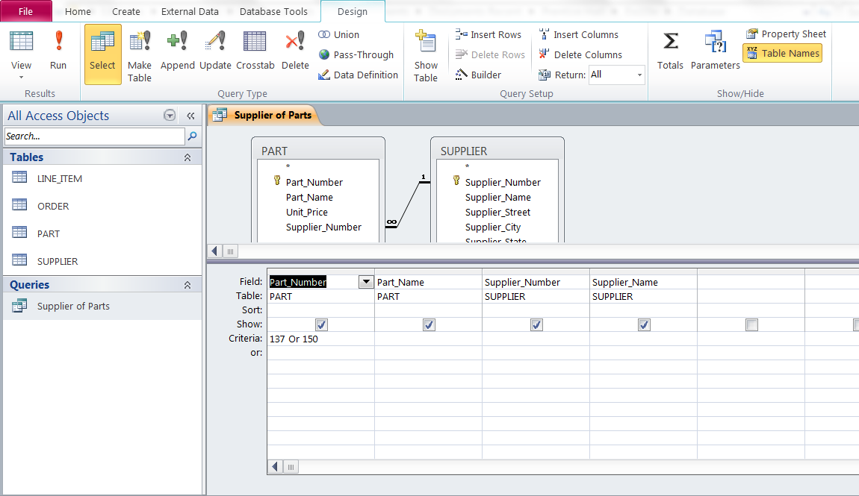
AN ACCESS QUERY
FIGURE 6-8
Illustrated here is how the query in Figure 6-7 would be constructed using Microsoft Access query building
tools. It shows the tables, fields, and selection criteria used for the query.
Notes:
This graphic illustrates a Microsoft Access query that performs the same operation as the SQL query in the last slide. The query pane at the bottom shows the fields that are requested (Fields), the relevant Tables (Table), the fields that will be displayed in the results (Show), and the criteria limiting the results to Part numbers 137 and 150 (Criteria).

Slide 20
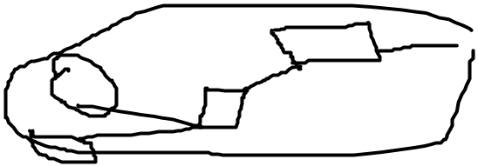
Capabilities of Database Management Systems (DBMSs)
Designing Databases
  Conceptual (logical) design: abstract model from business perspective
  Physical design: How database is arranged on direct-access storage devices
Design process identifies:
  Relationships among data elements, redundant database elements
  Most efficient way to group data elements to meet business requirements, needs of application programs
Normalization
  Streamlining complex groupings of data to minimize redundant data elements and awkward many-to-many relationships
Notes:
This slide describes activities involved in designing a database. To create an efficient database, you must know what the relationships are among the various data elements, the types of data that will be stored, and how the organization will need to manage the data. Note that the conceptual database design is concerned with how the data elements will be grouped, what data in what tables will make the most efficient organizations.

Slide 21
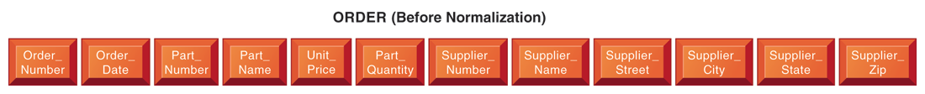
AN UNNORMALIZED RELATION FOR ORDER
FIGURE 6-9
An unnormalized relation contains repeating groups. For example, there can be many parts and suppliers for each order. There is only a one-to-one correspondence between Order_Number and Order_Date.
Notes:
The graphics on this slide and the next illustrate the process of normalization. Here, one table lists the relevant data elements for the entity ORDER. These include all of the details about the order, the part, the supplier.
An order can include more than one part, and it may be that several parts are supplied by the same supplier. However, using this table, the supplier’s name, and other information might need to be stored several times on the order list.

Slide 22
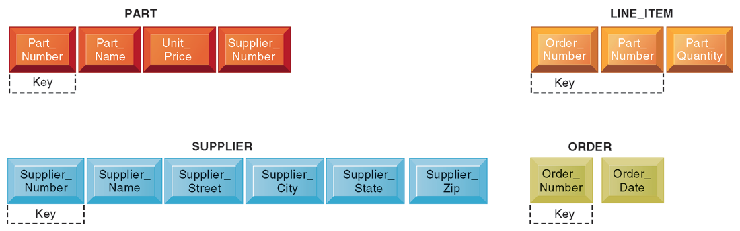
NORMALIZED TABLES CREATED FROM ORDER
FIGURE 6-10
After normalization, the original relation ORDER has been broken down into four smaller relations. The relation ORDER is left with only two attributes and the relation LINE_ITEM has a combined, or concatenated, key consisting of Order_Number and Part_Number.
Notes:
This graphic shows the normalized tables. The Order table has been broken down into four smaller, related tables. Notice that the Order table contains only two unique attributes, Order Number and Order Date. The multiple items ordered are stored using the Line_Item table. The normalization means that very little data has to be duplicated when creating orders, most of the information can be retrieved by using keys to the Part and Supplier tables.
It is important to note that relational database systems try to enforce referential integrity rules to ensure that relationships between coupled tables remain consistent. When one table has a foreign key that points to another table, you may not add a record to the table with the foreign key unless there is a corresponding record in the linked table. For example, foreign key Supplier_Number links the PART table to the SUPPLIER table. Referential integrity means that a new part can’t be added to the part table without a valid supplier number existing in the Supplier table. It also means that if a supplier is deleted, any corresponding parts must be deleted also.

Slide 23
Capabilities of Database Management Systems (DBMSs)
Referential integrity rules
  Used by RDMS to ensure relationships between tables remain consistent
Entity-relationship diagram
  Used by database designers to document the data model
  Illustrates relationships between entities
Caution: If a business doesn’t get data model right, system won’t be able to serve business well
Notes:
This slide continues the discussion about designing databases. One technique database designers use in modeling the structure of the data is to use an entity-relationship diagram (illustrated on the next slide). Symbols on the diagram illustrate the types of relationships between entities. Ask students what different types of relationships there are between entities (one-to-one, one-to-many, many-to-many).

Slide 24

AN ENTITY-RELATIONSHIP DIAGRAM
FIGURE 6-11
This diagram shows the relationships between the entities SUPPLIER, PART, LINE_ITEM, and ORDER that might be used to model the database in Figure 6-10.
Notes:
This graphic shows an example of an entity-relationship diagram. It shows that one ORDER can contain many LINE_ITEMs. (A PART can be ordered many times and appear many times as a line item in a single order.) Each LINE ITEM can contain only one PART. Each PART can have only one SUPPLIER, but many PARTs can be provided by the same SUPPLIER.

Slide 25
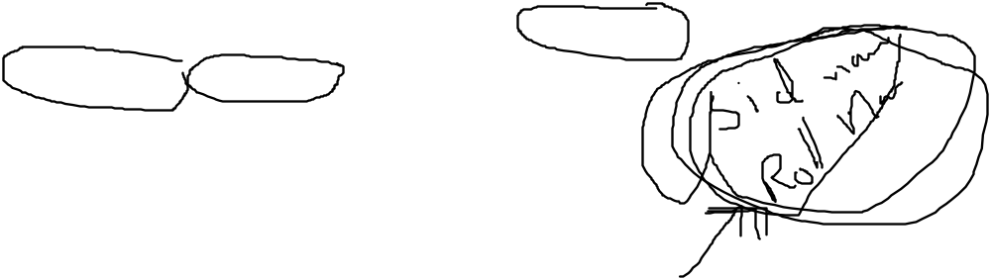
Tools for Improving Business Performance and Decision Making
Big data
  Massive sets of unstructured/semi-structured data from Web traffic, social media, sensors, and so on
  Petabytes, exabytes of data
    Volumes too great for typical DBMS
  Can reveal more patterns and anomalies
Notes:
This slide discusses how very large databases are used to produce valuable information for firms. The text gives the example of how, by analyzing data from customer credit card purchases, Louise’s Trattoria, a Los Angeles restaurant chain, learned that quality was more important than price for most of its customers, who were college educated and liked fine wine. The chain responded to this information by introducing vegetarian dishes, more seafood selections, and more expensive wines, raising sales by more than 10%.

Slide 26
Tools for Improving Business Performance and Decision Making
Business intelligence infrastructure
  Today includes an array of tools for separate systems, and big data
Contemporary tools:
  Data warehouses
  Data marts
  Hadoop
  In-memory computing
  Analytical platforms
Notes:
Business intelligence is a very amorphous notion that is not well defined. In this course we refer instead to a “business intelligence” environment which is composed of many different components (including both technology and management dimensions).

Slide 27
Tools for Improving Business Performance and Decision Making
Data warehouse:
  Stores current and historical data from many core operational transaction systems
  Consolidates and standardizes information for use across enterprise, but data cannot be altered
  Provides analysis and reporting tools
Data marts:
  Subset of data warehouse
  Summarized or focused portion of data for use by specific population of users
  Typically focuses on single subject or line of business
Notes:
This slide discusses the use of data warehouses and data marts by firms.
Ask students why having a data warehouse is an advantage for firms hoping to perform business analyses on the data? Why does there have to be a repository of data that is separate from the transaction database?

Slide 28
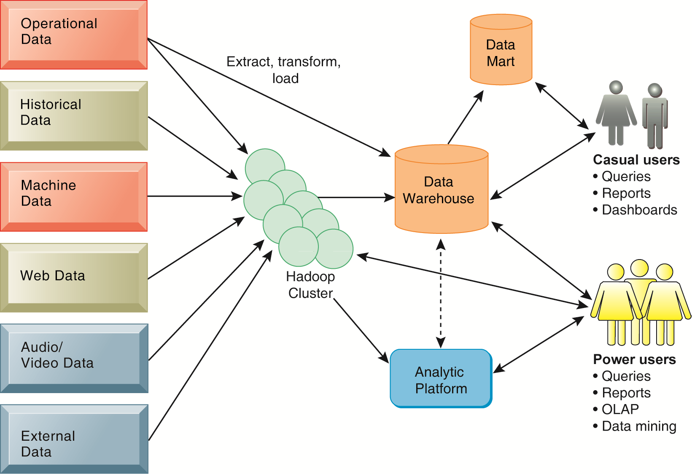
CONTEMPORARY BUSINESS INTELLIGENCE INFRASTRUCTURE
A contemporary business intelligence infrastructure features capabilities and tools to manage and
analyze large quantities and different types of data from multiple sources. Easy-to-use query and
reporting tools for casual business users and more sophisticated analytical toolsets for power users
are included.
FIGURE 6-12
Notes:
This graphic illustrates the components of a data warehouse system. It shows that the data warehouse extracts data from multiple sources, both internal and external, including a Hadoop cluster, and transforms it as needed for the data warehouse systems. An analytic platform has tools for power users, including reporting, OLAP, and data mining, to extract meaningful information from the data warehouse and Hadoop cluster. A subset of the data warehouse is collected in a data mart for casual groups of users.

Slide 29
Tools for Improving Business Performance and Decision Making
Hadoop
  Enables distributed parallel processing of big data across inexpensive computers
  Key services
    Hadoop Distributed File System (HDFS): data storage
    MapReduce: breaks data into clusters for work
    Hbase: NoSQL database
  Used by Facebook, Yahoo, NextBio

Slide 30
Tools for Improving Business Performance and Decision Making
In-memory computing
  Used in big data analysis
  Uses computers main memory (RAM) for data storage to avoid delays in retrieving data from disk storage
  Can reduce hours/days of processing to seconds
  Requires optimized hardware
Analytic platforms
  High-speed platforms using both relational and non-relational tools optimized for large datasets

Slide 31
Driving ARI Fleet Management with Real-Time Analytics
Why was data management so problematic at ARI?
Describe ARI’s earlier capabilities for data analysis and reporting and their impact on the business.
Was SAP HANA a good solution for ARI? Why or why not?
Describe the changes in the business as a result of adopting HANA.

Slide 32
Tools for Improving Business Performance and Decision Making
Analytical tools: Relationships, patterns, trends
  Tools for consolidating, analyzing, and providing access to vast amounts of data to help users make better business decisions
    Multidimensional data analysis (OLAP)
    Data mining
    Text mining
    Web mining
Notes:
This slide illustrates the role and types of analytical tools and techniques for finding useful information and relationships in large data sets.

Slide 33

Tools for Improving Business Performance and Decision Making
Online analytical processing (OLAP)
  Supports multidimensional data analysis
    Viewing data using multiple dimensions
    Each aspect of information (product, pricing, cost, region, time period) is different dimension
    Example: How many washers sold in the East in June compared with other regions?
  OLAP enables rapid, online answers to ad hoc queries
Notes:
This slide discusses online analytical processing, one of the three principle tools for gathering business intelligence.
Ask students to come up with additional examples of what a multidimensional query might be.

Slide 34
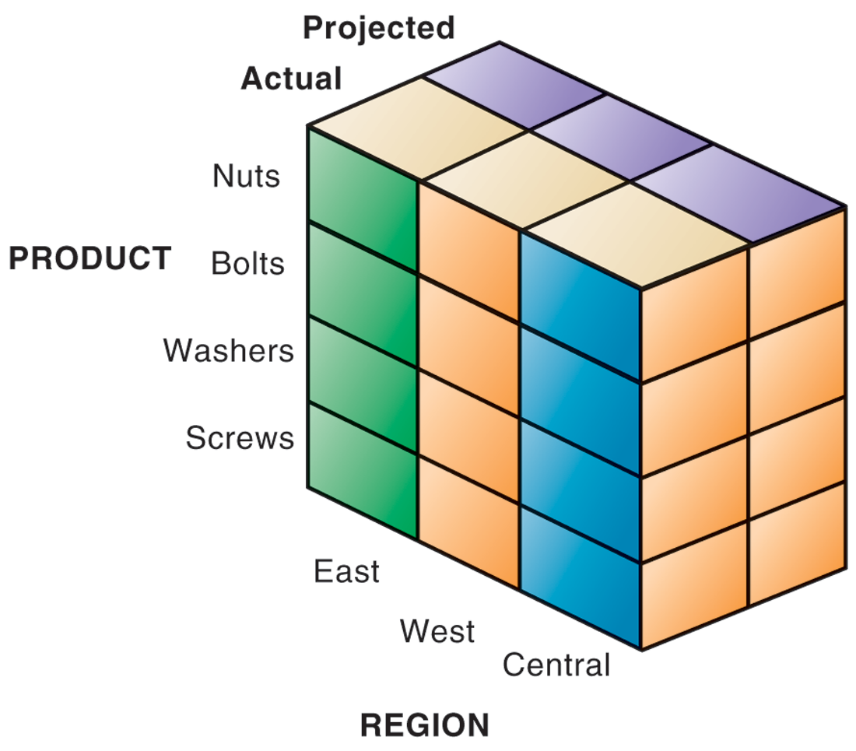
MULTIDIMENSIONAL DATA MODEL
The view that is showing is product versus region. If you rotate the cube 90 degrees, the face that will show product versus actual and projected sales. If you rotate the cube 90 degrees again, you will see region versus actual and projected sales. Other views are possible.
FIGURE 6-13
Notes:
This graphic illustrates the concept of dimensions as it relates to data. Product is one dimension. East is a dimension, and projected and actual sales are two more dimensions. Altogether, we are trying to analyze four dimensions. The business question is: In the Eastern region, what are the actual and projected sales of our products (nuts, bolts, washers, and screws)? Sometimes referred to as a “data cube,” the graphic can depict this four dimensional view of the data. More importantly, when compared to a spreadsheet model of the same data, a graphical data cube is much faster, easier to understand and visualize the relationships.

Slide 35
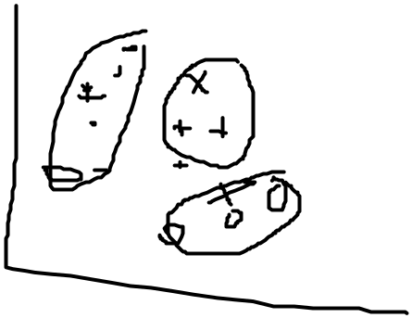
Tools for Improving Business Performance and Decision Making
Data mining:
  Finds hidden patterns, relationships in datasets
    Example: customer buying patterns
  Infers rules to predict future behavior
  Types of information obtainable from data mining:
    Associations
    Sequences
    Classification
    Clustering
    Forecasting
Notes:
This slide discusses another business intelligence tool driven by databases, data mining. Data mining provides insights into data that cannot be discovered through OLAP, by inferring rules from patterns in data.
Ask students to describe the types of information listed:
Associations: Occurrences linked to single event
Sequences: Events linked over time
Classification: Recognizes patterns that describe group to which item belongs
Clustering: Similar to classification when no groups have been defined; finds groupings within data
Forecasting: Uses series of existing values to forecast what other values will be

Slide 36
Tools for Improving Business Performance and Decision Making
Text mining
  Extracts key elements from large unstructured data sets
    Stored e-mails
    Call center transcripts
    Legal cases
    Patent descriptions
    Service reports, and so on
  Sentiment analysis software
    Mines e-mails, blogs, social media to detect opinions
Notes:
Whereas data mining describes analysis of data in databases, there are other types of information that can be “mined,” such as text mining and Web mining. Ask students what other types of unstructured textual data sets a company might store, and what kind of useful information might be extracted from them.

Slide 37
Tools for Improving Business Performance and Decision Making
Web mining
  Discovery and analysis of useful patterns and information from Web
    Understand customer behavior
    Evaluate effectiveness of Web site, and so on
  Web content mining
    Mines content of Web pages
  Web structure mining
    Analyzes links to and from Web page
  Web usage mining
    Mines user interaction data recorded by Web server
Notes:
This slide continues the exploration of mining stored data for valuable information. In addition to text mining, there are several ways to mine information on the Web. The text uses the example of marketers using Google Trends and Google Insights for Search services, which track the popularity of various words and phrases used in Google search queries, to learn what people are interested in and what they are interested in buying. What type of Web mining is this? Why might a marketer be interested in the number of Web pages that link to a site?

Slide 38
Tools for Improving Business Performance and Decision Making
Databases and the Web
  Many companies use Web to make some internal databases available to customers or partners
  Typical configuration includes:
    Web server
    Application server/middleware/CGI scripts
    Database server (hosting DBMS)
  Advantages of using Web for database access:
    Ease of use of browser software
    Web interface requires few or no changes to database
    Inexpensive to add Web interface to system
Notes:
This slide looks at how companies utilize the Web to access company databases. Ask students to describe the flow of information from a company’s databases to the Web page a user is accessing data on. Why is browser software easy to use? Why is it less expensive to add a Web interface to a database-driven information system?

Slide 39
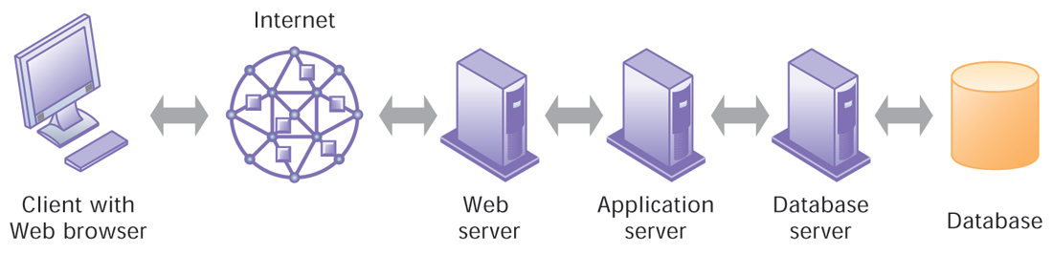
LINKING INTERNAL DATABASES TO THE WEB
FIGURE 6-14
Users access an organization’s internal database through the Web using their desktop PCs and Web browser software.
Notes:
This graphic illustrates the way data is passed from a database through to a user with a Web browser. Ask students to describe what types of data transformation occur between the various appliances, for example, what happens to data as it flows from the database to the database server? Answer: data in the database is stored using the data format required by the database software. This formatted data needs to be transformed into an XML format for presentation on the Web. The database server makes this transformation and passes it along to the application server which uses it to populate (or construct) an HTML Web page. The Web page is then sent to the Web server which sends it over the Internet as an HTML Web page, which is finally displayed on the users screen. Although each of these software functions is represented by a separate computer in the illustration, in fact all these servers can and often do reside on a single computer as software.

Slide 40
Managing the Firm’s Data Resources
Establishing an information policy
  Firm’s rules, procedures, roles for sharing, managing, standardizing data
  Data administration
    Establishes policies and procedures to manage data
  Data governance
    Deals with policies and processes for managing availability, usability, integrity, and security of data, especially regarding government regulations
  Database administration
    Creating and maintaining database
Notes:
This slide discusses the firm’s need for an information policy in order to ensure that firm data is accurate, reliable, and readily available. Note that although the database administration group establishes and creates the physical database, the data administration function is responsible for logical database design and data dictionary development. Why would this function be better placed with the data administration group?

Slide 41
Managing Data Resources
Ensuring data quality
  More than 25 percent of critical data in Fortune 1000 company databases are inaccurate or incomplete
    Redundant data
    Inconsistent data
    Faulty input
  Before new database in place, need to:
    Identify and correct faulty data
    Establish better routines for editing data once database in operation
Notes:
This slide discusses the importance of data quality. Ask students for personal examples of what happens when a company’s data is faulty. The text provides an example of one study finding that 10 to 25 percent of customer and prospect records contain critical data errors. Has anyone in class directly experienced a problem with the accuracy of data about them stored on computer systems?

Slide 42
Managing Data Resources
Data quality audit:
  Structured survey of the accuracy and level of completeness of the data in an information system
    Survey samples from data files, or
    Survey end users for perceptions of quality
Data cleansing
  Software to detect and correct data that are incorrect, incomplete, improperly formatted, or redundant
  Enforces consistency among different sets of data from separate information systems
Notes:
This slide continues the discussion of data quality and examines ways to improve the firm’s data quality. Ask students what types of data quality problems there are (data that is incomplete, inaccurate, improperly formatted, redundant). Ask students if user perceptions of quality are as important as statistical evidence of data quality problems. What is another word for data cleansing?

Slide 43
American Water Keeps Data Flowing
Discuss the role of information policy, data administration, and efforts to ensure data quality in improving data management at American Water.
Describe roles played by information systems specialists and end users in American Water’s systems transformation project.
Why was the participation of business users so important? If they didn’t play this role, what would have happened?

Slide 44
American Water Keeps Data Flowing (cont.)
How did implementing a data warehouse help American Water move toward a more centralized organization?
Give some examples of problems that would have occurred at American Water if its data were not “clean”?
How did American Water’s data warehouse improve operations and management decision making?

